Slide 1
Improved Single and Multiple String Matching Algorithms
A SAI KARTHIK
B150310CS
B PRAVEEN KUMAR REDDY
B150691CS

Slide 2
Introduction
String matching is the process of searching for the occurrence of a specified pattern in a given text.
Information Retrieval Systems(IRS) are playing an eminent role in different applications like World Wide Web, DNA sequence retrieval, etc.
The IRS systems use the string matching algorithms to identify the location of the required data in the system.
If the string matching algorithms are improved then the IRS systems work more efficiently.

Slide 3
Problem Definition
Given a set of gene patterns and a gene sequence find the positions at which the gene patterns occur within the sequence.
Improving the time complexity for the above requirement.

Slide 4
Literature Survey
Naïve String Matching Algorithm:
Time complexity: O(m*n) n: length of gene sequence;
m: length of pattern
Finite State Machine:
Time complexity: Preprocessing: O(m^3*c)
Searching: O(n)
c: number of characters in text and pattern
n: length of gene sequence;
m: length of longest pattern
Rabin Karp Algorithm:
Time complexity: average: O(m+n) n: length of longest pattern
worst case: O(m*n) m: length of gene sequence;

Slide 5
Single Pattern Matching Knuth Morris Pratt – KMP algorithm
We construct an array containing the length of longest common prefix and suffixes for all the values in a pattern.
Whenever a mismatch occurs rather than going to the start of the pattern we start matching from the end of common prefix.
Preprocessing: Compute the longest common prefix and suffix array.
Main step: Iterate through the gene sequence with the pattern.
Time Complexity: O(n+m) n: length of gene sequence;
m: length of longest pattern
Example: txt[]: AAAAABAABA
pat[]: AAAA
lps[]: {0,1,2,3}

Slide 6
Multiple pattern String matching
When multiple patterns are given {he, she , his, hers} and we need to do string matching on the given text.
KMP algorithm constructs the LPS array for every pattern and hence the resulting time complexity is:
Time complexity: O(k*(n+m))
k: number of patterns n: length of gene sequence
m: length of longest pattern

Slide 7
Aho-Corasick Algorithm
Aho Corasick Algorithm constructs a trie on the given patterns and then constructs a finite automata on trie.
Then the finite automata is used to evaluate the the gene sequence and find patterns inside it.
Time Complexity: O(n + m + k) n:length of gene sequence
m:total number of characters in all patterns
k: number of occurrences of patterns in the sequence

Slide 8
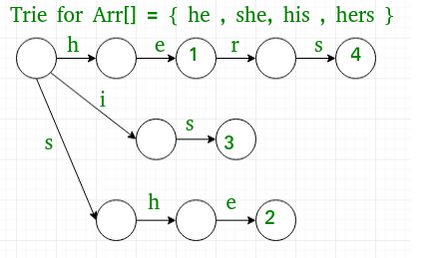
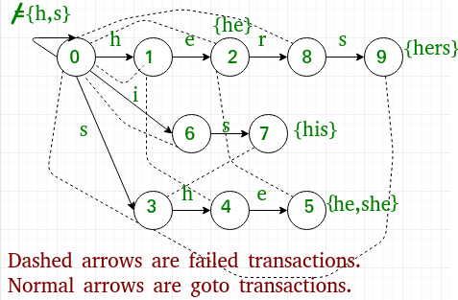
Pre Processing
Go To : This function simply follows edges
of Trie of all words in arr[]. It is
represented as 2D array g[][] where
we store next state for current state
and character.
Failure : This function stores all edges that are
followed when current character doesn't
have edge in Trie. It is represented as
1D array f[] where we store next state for
current state.
Output : Stores indexes of all words that end at
current state. It is represented as 1D
array o[] where we store indexes
of all matching words as a bitmap for
current state.
For the failure function we use breadth first search to find the longest common prefix and suffix and compute which state to drop to.

Slide 9
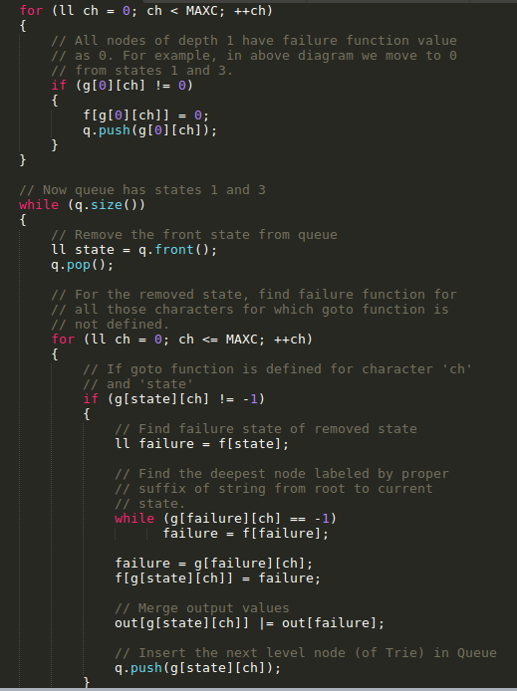
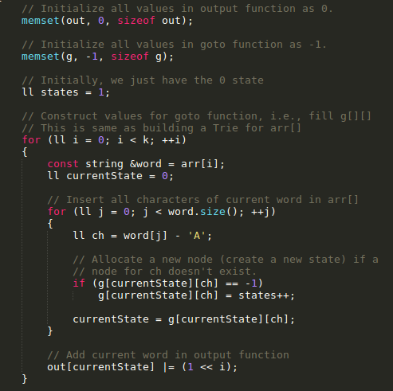

Slide 10
Running the algorithm on the finite automata
Now the gene sequence can be simulated on the finite automata in a single loop and looking up the transition table.
This happens in linear time.

Slide 11
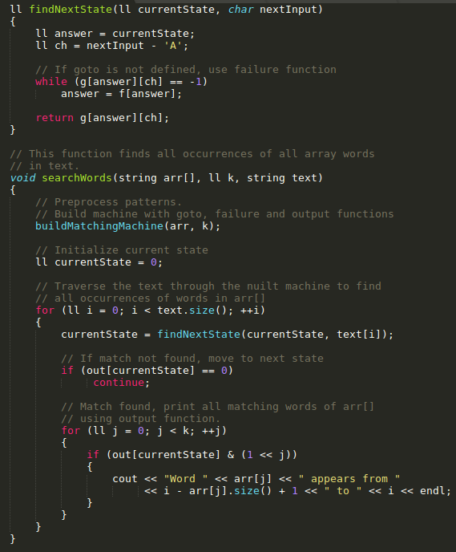

Slide 12
Running the algorithms on dataset
In general a monkey chromosome contains 10 (TAGA,
TCAT, GAAT, AGAT, AGAA, GATA, TATC, CTTT, TCTG
and TCTA) Complex DNA Index Structures (CODIS),
here these 10 CODIS are considered as search patterns.
To assess the efficiency of the string matching
algorithms, the chromosomes of Pan paniscus was considered as dataset.
Machine specifications
Intel Quad Core@ 2.2 Ghz
4GB Ram
Algorithm | Rabin Karp | KMP | Aho-Corasick
Pan Paniscus PanPan | 88.2444 | 53.2859 | 35.4649

Slide 13
Conclusions
The single and multiple pattern string matching algorithms are executed with DNA genome data sets. The experimental results have shown that the single pattern string matching algorithm(KMP algorithm) reduced the search time when compared with other string matching algorithms.
Whereas, the multiple string matching algorithms out-perform in terms of search time as compared to proposed single pattern and existing string matching algorithms.

